Slide 1
biology art integration project
Crop production and management

Slide 2
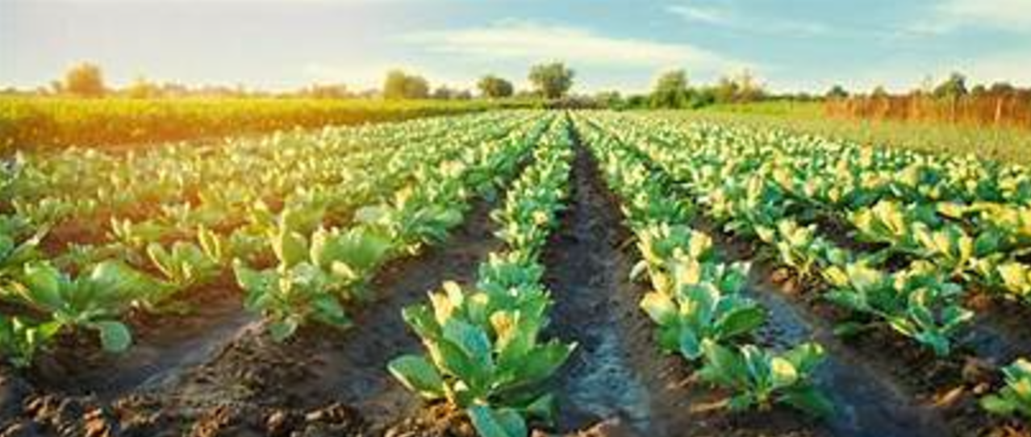
WHAT IS CROP PRODUCTION MANAGEMENT ??
Crop production management is a set of agricultural practices that improve the growth, development, and yield of crops. It involves the use of land, water, labor, and other inputs to produce food and fiber
THE IMPORTANT REQUIREMENTS ARE:
NUTRIENT MANAGEMENT(MANURE, FERTILIZERS)
IRRIGATION
CROPPING PATTERNS
.

Slide 3
Nutrient management:
Air, water, and soil are all sources of nutrients for plants. Macronutrients and micronutrients are the two types of nutrients found in plants.
Carbon and oxygen are both supplied by air. Hydrogen and oxygen are both found in water.
Plants get the remaining 13 nutrients from the soil.
Plants' physiological activities, such as reproduction, growth, and disease susceptibility, are affected by nutritional deficiencies
. The soil can be improved by adding these nutrients in the form of manure and fertilizers to increase output.
Furthermore, to Increase nutrients we have to add manure and fertilizers

Slide 4
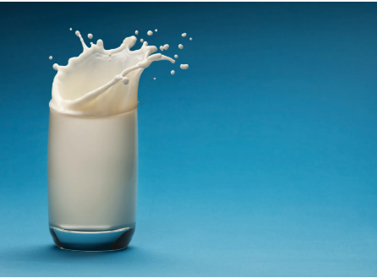
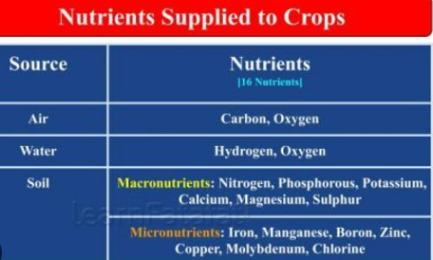

The nutrients supplied by air water and soil:

Slide 5
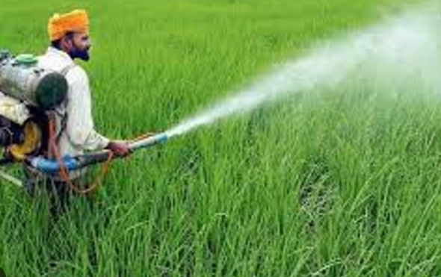
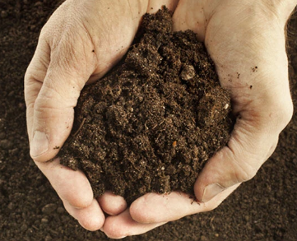
Manure & fertilzers
Manure is obtained naturally by the decomposition of dead plants and animals.
Fertilizers are chemical substances and are not typically natural. It is not very rich in nutrients.
It is rich in soil nutrients like nitrogen, phosphorous, and potassium.

Slide 6
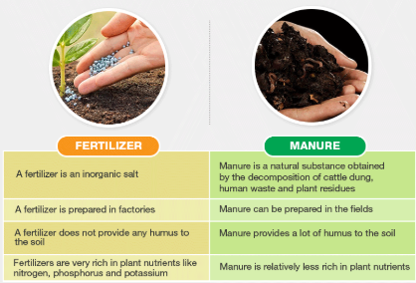
Difference between manure and fertilizers

Slide 7
Different types of manure
Green Manure
Green manure increases the percentage of organic matter in the soil. The roots of such manures go deep into the soil. These help in the suppression of weeds and the prevention of soil erosion.
Farmyard Manure
Farmyard manure improves the soil structure and is used as a natural fertilizer in farming. It increases the soil capacity to hold more water and nutrients. It also increases the microbial activity of the soil to improve its mineral supply and also the plant nutrients.
Compost Manure
It improves the soil structure and water and nutrient holding capacity of the soil. Thus, it increases the nutrient value and thereby improves the health of the plants.

Slide 8
irrigation
The process of supplying water to crop plants through human efforts by means of canals, wells, tube wells etc is known as irrigation.
Agriculture in India is rain-fed. Justification: The success of crops in most part of India depends on water from rainfall during the growing season of the crop plants.
IRRIGATION CAN BE DONE THROUGH:
Tube wells: A man-made source of water for irrigation. A tube well is a long, narrow pipe bored into the ground, with a strainer at the bottom. A pump lifts water from the well for irrigation

Slide 9
irrigation
Ponds: A natural source of water for irrigation
Rivers: A natural source of water for irrigation
Dams: A man-made source of water for irrigation
Canals: A man-made source of water for irrigation
Wells: A source of water for irrigation
.
Lakes: A natural source of water for irrigation

Slide 10
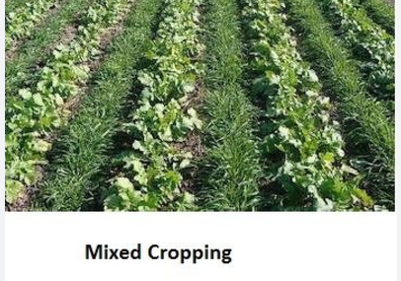
CROPPING PATTERNS
Mixed Cropping: When two or more crops are grown on an equivalent land simultaneously, it's referred to as mixed cropping
. For example, growing wheat and gram on an equivalent land at an equivalent time is mixed cropping.
The practice of this method helps to minimize the risk of the failure of one of the crops and provides insurance against the crop failure due to abnormal weather conditions
The crops that are grown together should have a
different maturation tim and different water requirements.

Slide 11
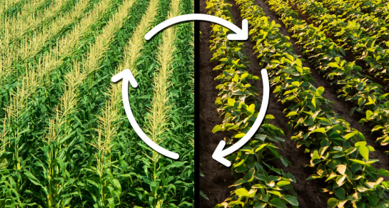
INTERCROPPING AND CROP ROTATION
INTERCROPPING:
In this pattern, different crops are grown on equivalent land in pre-planned succession. The crops are classified based on the time they are rotated one-year rotation, two-year rotation, and three-year rotation, depending upon their duration. Legumes are included within the crop rotation program to extend soil fertility.
CROP ROTATION:
In this pattern, different crops are grown on equivalent land in pre-planned succession. The crops are classified based on the time they are rotated one-year rotation, two-year rotation, and three-year rotation, depending upon their duration. Legumes are included within the crop rotation program to extend soil fertility
.

Slide 12

OUR TEAM MEMBERS:
SURYA
RUDHRESH
SANJITH RAM
KIRUTHIK PRANAV
HARI
KASSI
PAVAN
NATHUL

